Slide 1
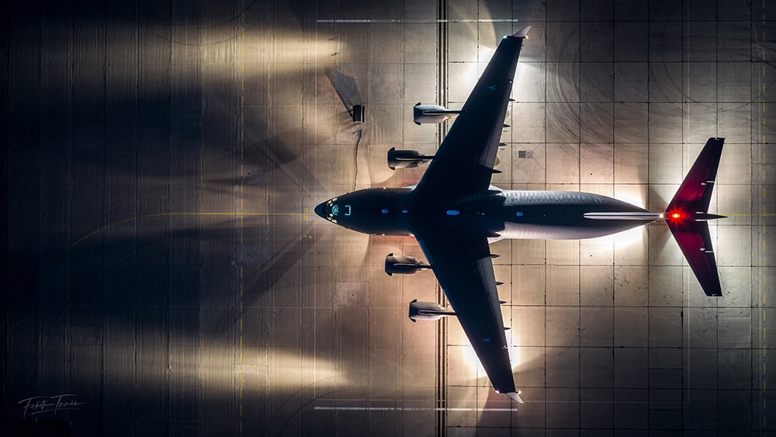
They want us to fax 80 pages???
Captain Christian Brechbuhl – 437th Airlift Wing (AMC)

Slide 2
Background
Just landed
Awake for almost 30 hours
Flying for almost two weeks (24-30 awake, 8 asleep)
Documented most info throughout trip
Spent last flight double checking your crew’s work
Now you, your crew, and support staff will spend hours transcribing data into 6+ different systems
The data will take more than a week to be available to decision makers

Slide 3
Potential Solutions
iPad App
Allows us to enter data as we fly, upload when we land
Validates data against known rules to check for errors (times not adding up, etc.)
Scanning software
Automatically extracts data from the paper originals

Slide 4
Acquisition
Initial
Wing Innovation Funds
Full Adoption
SBIR process
TWCF Monies

Slide 5
Ever flown with the doors open? Touched another plane at 300 mph? Charleston is a great town to visit

Slide 6
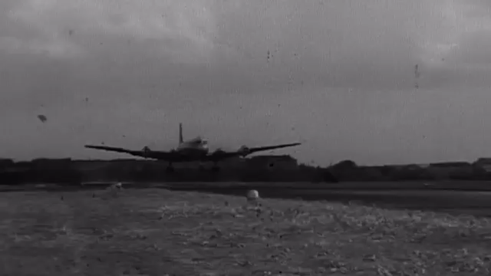
Questions?

